Slide 1
Lecture 1: Perceptron and Back Propagation

Slide 2
Outline
Introduction to Artificial Neural Networks
Review of Classification and Logistic Regression
Introduction to Optimization
Gradient Descent
Stochastic Gradient Descent
Back Propagation
Single Neuron Network (‘Perceptron’)
Multi-Layer Perceptron

Slide 3
Watch this!
http://video.arstechnica.com/watch/sunspring-sci-fi-short-film

Slide 4
Artificial Neural Networks

Slide 5

Today’s news

Slide 6

Today’s news

Slide 7
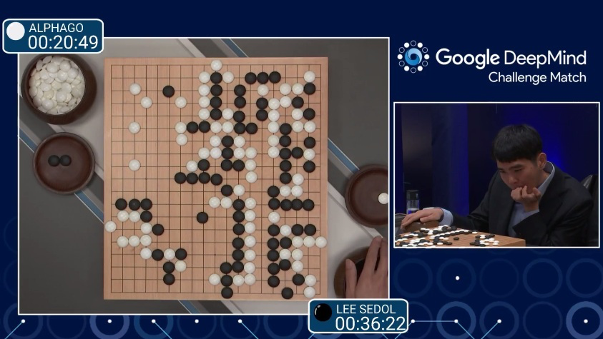
AlphaGo (2015)
First program to beat a professional Go player
Notes:
https://www.youtube.com/watch?v=PQCrX1sQSzY

Slide 8

AlphaZero (2017)

Slide 9

iOS Speech Synthesis (2016-)
Trained from 20 hours of high quality speech
machinelearning.apple.com
Notes:
https://machinelearning.apple.com/2017/08/06/siri-voices.html

Slide 10

Google Brain (2012)
Differentiate between human face and cat
Neural network with 1 billion connections
10 million 200x200 pixel images from YouTube
Le et al., ICML 2012

Slide 11
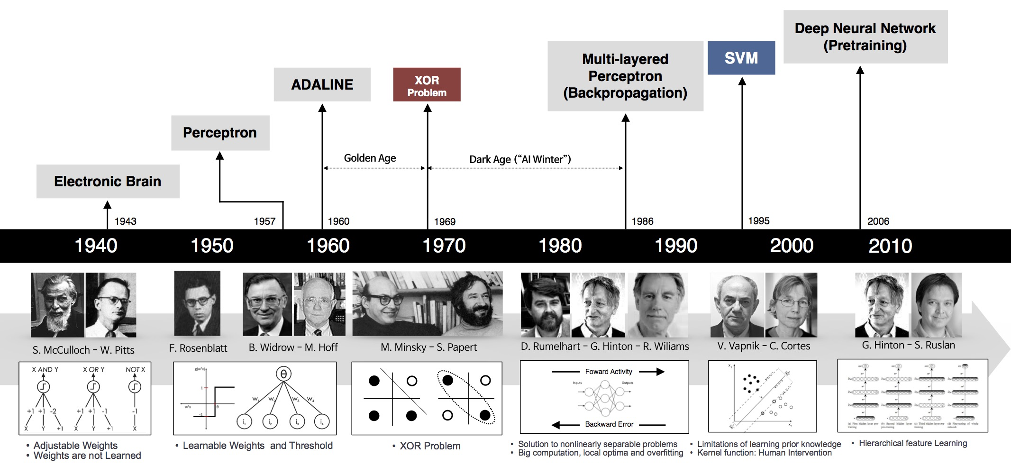
Historical Trends
beamandrew.github.io/

Slide 12
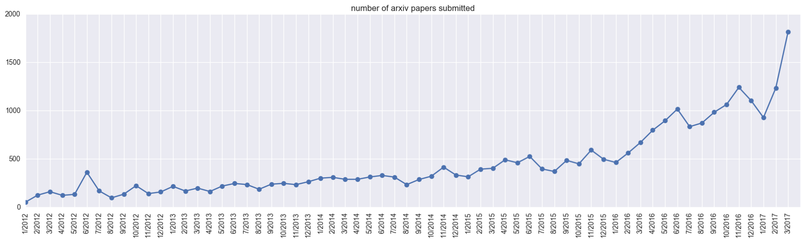
Historical Trends
ArXiv papers on deep learning: 2012-2017

Slide 13
Classification and Logistic Regression

Slide 14
Heart Data
response variable Y
is Yes/No
Age | Sex | ChestPain | RestBP | Chol | Fbs | RestECG | MaxHR | ExAng | Oldpeak | Slope | Ca | Thal | AHD
63 | 1 | typical | 145 | 233 | 1 | 2 | 150 | 0 | 2.3 | 3 | 0.0 | fixed | No
67 | 1 | asymptomatic | 160 | 286 | 0 | 2 | 108 | 1 | 1.5 | 2 | 3.0 | normal | Yes
67 | 1 | asymptomatic | 120 | 229 | 0 | 2 | 129 | 1 | 2.6 | 2 | 2.0 | reversable | Yes
37 | 1 | nonanginal | 130 | 250 | 0 | 0 | 187 | 0 | 3.5 | 3 | 0.0 | normal | No
41 | 0 | nontypical | 130 | 204 | 0 | 2 | 172 | 0 | 1.4 | 1 | 0.0 | normal | No

Slide 15
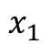
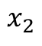
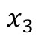
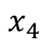
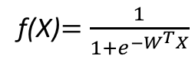
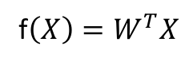
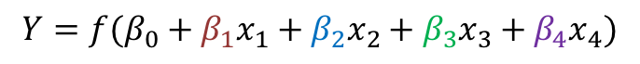
But what is the idea?
Start with Regression or Logistic Regression
f(X)$=\frac{1}{{1+e}^{−W^{T}X}}$
f$\left(X\right)=W^{T}X$
$$x_{1}$$
$$x_{2}$$
$$Y=f(β_{0}+β_{1}x_{1}+β_{2}x_{2}+β_{3}x_{3}+β_{4}x_{4})$$
$$x_{3}$$
$$x_{4}$$
Intercept or Bias
Coefficients or Weights

Slide 16
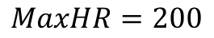
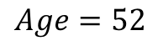
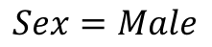
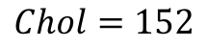
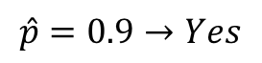
But what is the idea?
Start with all randomly selected weights. Most likely it will perform horribly.
For example, in our heart data, the model will be giving us the wrong answer.
$$MaxHR=200$$
Correct
$$Age=52$$
$$\hat{p}=0.9→Yes$$
y=No
$$Sex=Male$$
$$Chol=152$$
Bad Computer

Slide 17
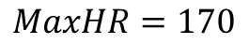
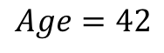
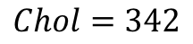
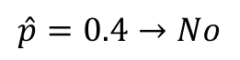
But what is the idea?
Start with all randomly selected weights. Most likely it will perform horribly.
For example, in our heart data, the model will be giving us the wrong answer.
$$MaxHR=170$$
Correct
$$Age=42$$
$$\hat{p}=0.4→No$$
y=Yes
$$Sex=Male$$
$$Chol=342$$
Bad Computer

Slide 18
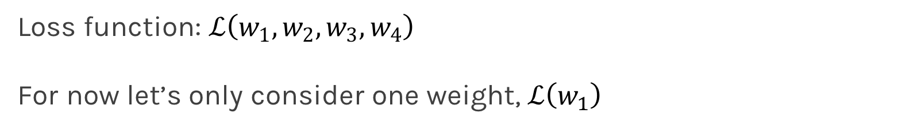
But what is the idea?
Loss Function: Takes all of these results and averages them and tells us how bad or good the computer or those weights are.
Telling the computer how bad or good is, does not help.
You want to tell it how to change those weights so it gets better.
Loss function: $ℒ\left(w_{1},w_{2},w_{3},w_{4}\right)$
For now let’s only consider one weight, $ℒ\left(w_{1}\right)$

Slide 20
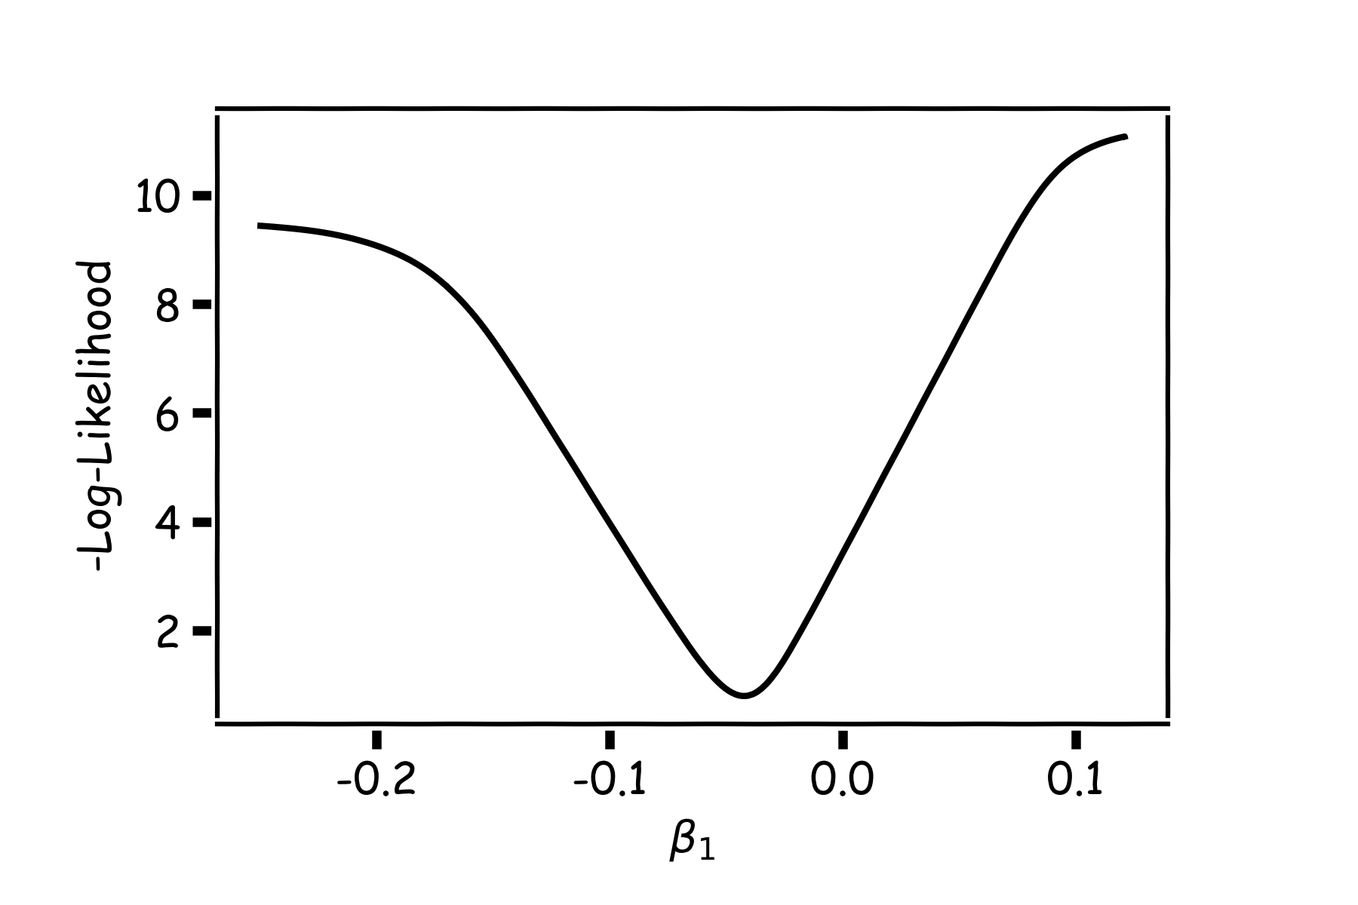
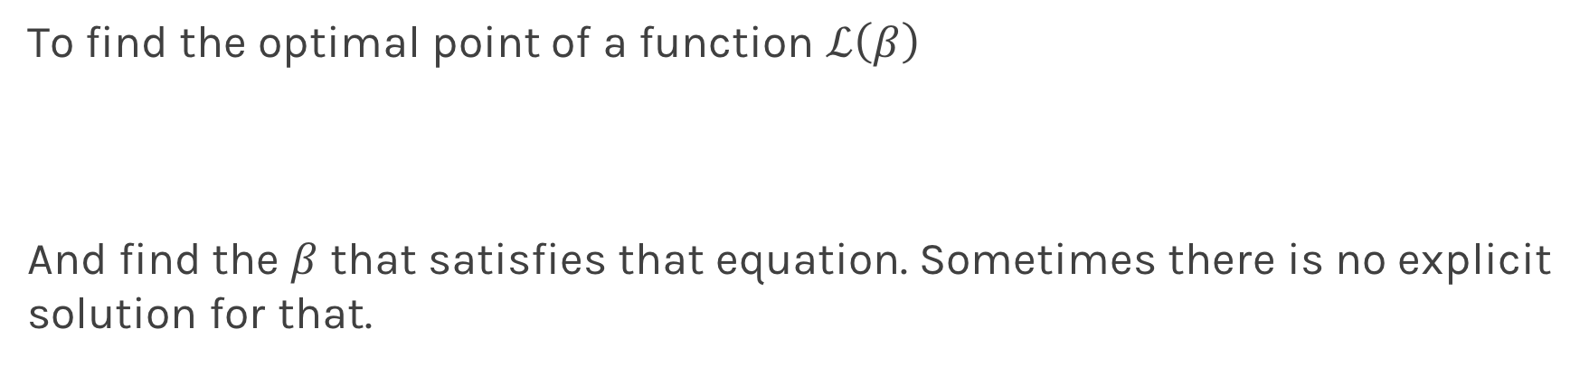
Minimizing the Loss function
Ideally we want to know the value of $w_{1}$ that gives the minimul $ℒ\left(β\right)$
To find the optimal point of a function $ℒ\left(β\right)$
And find the $β$ that satisfies that equation. Sometimes there is no explicit solution for that.

Slide 21
Minimizing the Loss function
A more flexible method is
Start from any point
Determine which direction to go to reduce the loss direction (left or right)
Specifically if you can calculate the slope of the function at this point
Shift to the right if slope is negative or shift to the left if slope is positive
Repeat

Slide 22
Minimization of the Loss Function
If the step is proportional to the slope then you avoid overshooting the minimum.
Question: What is the mathematical function that describes the slope?
Question: How do we generalize this to more than one predictor?
Question: What do you think it is a good approach for telling the model how to change (what is the step size) to become better?

Slide 23
Minimization of the Loss Function
If the step is proportional to the slope then you avoid overshooting the minimum.
Question: What is the mathematical function that describes the slope? Derivative
Question: How do we generalize this to more than one predictor?
Take the derivative with respect to each coefficient and do the same sequentially
Question: What do you think it is a good approach for telling the model how to change (what is the step size) to become better?

Slide 24
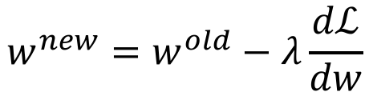
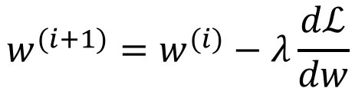
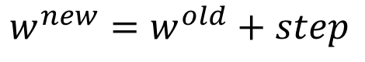
Let’s play the Pavlos game
We know that we want to go in the opposite direction of the derivative and we know we want to be making a step proportionally to the derivative.
Making a step means:
$${w^{new}=w}^{old}+step$$
Learning Rate
Inversely proportional to the derivative means:
$${w^{new}=w}^{old}−λ\frac{dℒ}{dw}$$
$${w^{(i+1)}=w}^{(i)}−λ\frac{dℒ}{dw}$$
Change to more conventional notation:

Slide 25
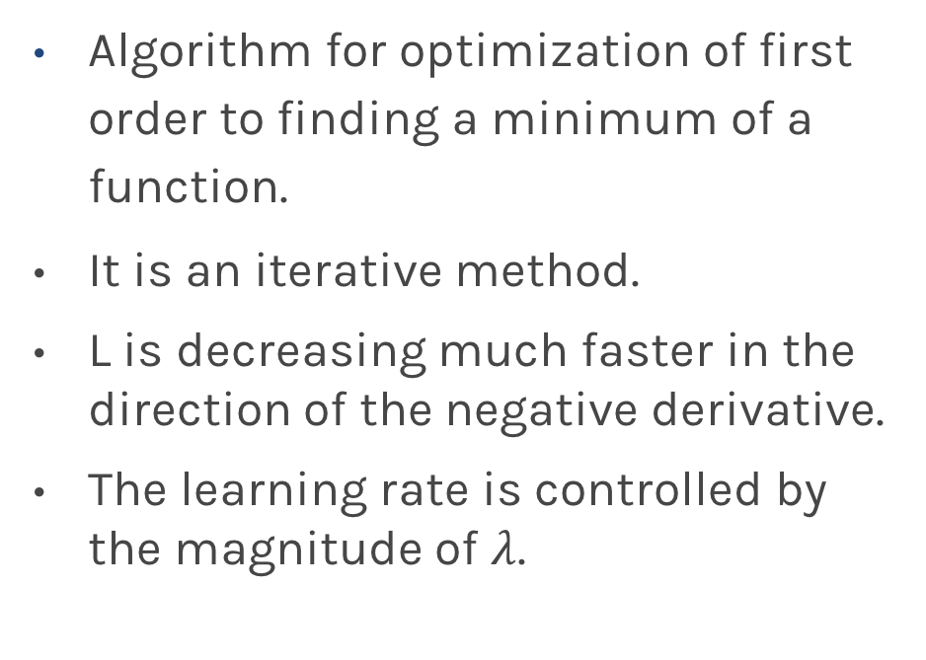
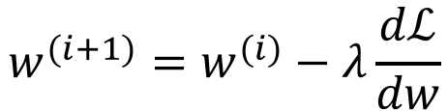
Gradient Descent
Algorithm for optimization of first order to finding a minimum of a function.
It is an iterative method.
L is decreasing much faster in the direction of the negative derivative.
The learning rate is controlled by the magnitude of $λ$.
$${w^{(i+1)}=w}^{(i)}−λ\frac{dℒ}{dw}$$
L
-
+
w

Slide 26
Considerations
We still need to calculate the derivatives.
We need to know what is the learning rates or how to set it.
Local vs global minima.
The full likelihood function includes summing up all individual ‘errors’. Unless you are a statistician, sometimes this includes hundreds of thousands of examples.

Slide 27
Derivatives: Memories from middle school

Slide 28
Linear Regression

Slide 29
Logistic Regression

Slide 30
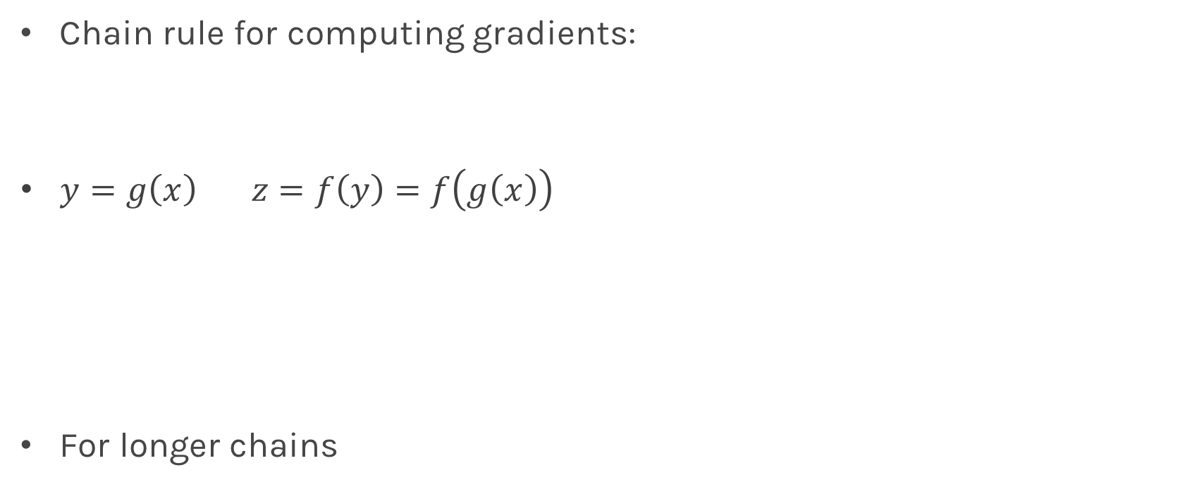
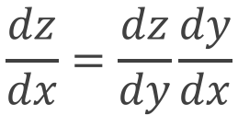
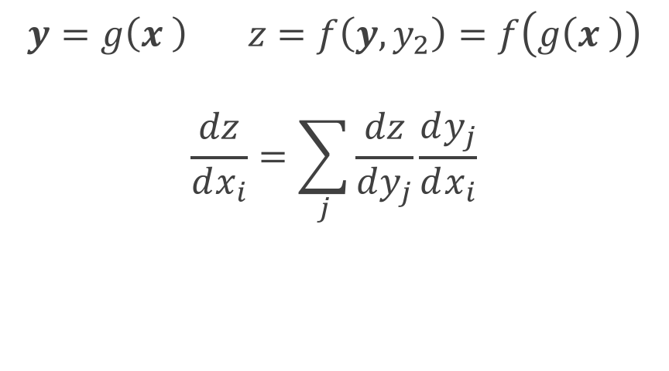
Chain Rule
Chain rule for computing gradients:
$y=g\left(x\right) z=f\left(y\right)=f\left(g\left(x\right)\right)$
For longer chains
$$y=g\left(x \right) z=f\left(y,y_{2}\right)=f\left(g\left(x \right)\right)$$
$$\frac{dz}{dx_{i}}=\sum_{j}{\frac{dz}{dy_{j}}\frac{dy_{j}}{dx_{i}}}$$
$$\frac{dz}{dx}=\frac{dz}{dy}\frac{dy}{dx}$$

Slide 31
Logistic Regression
$$ℒ=\sum_{i}{ℒ_{i}}=−\sum_{i}{\log{L_{i}}}{=−\sum_{i}{y_{i}\log{p_{i}+\left(1−y_{i}\right)\log{(1−p_{i})}=\sum_{i}{{(ℒ}_{i}^{A}+ℒ_{i}^{ B}})}}}$$

Slide 32
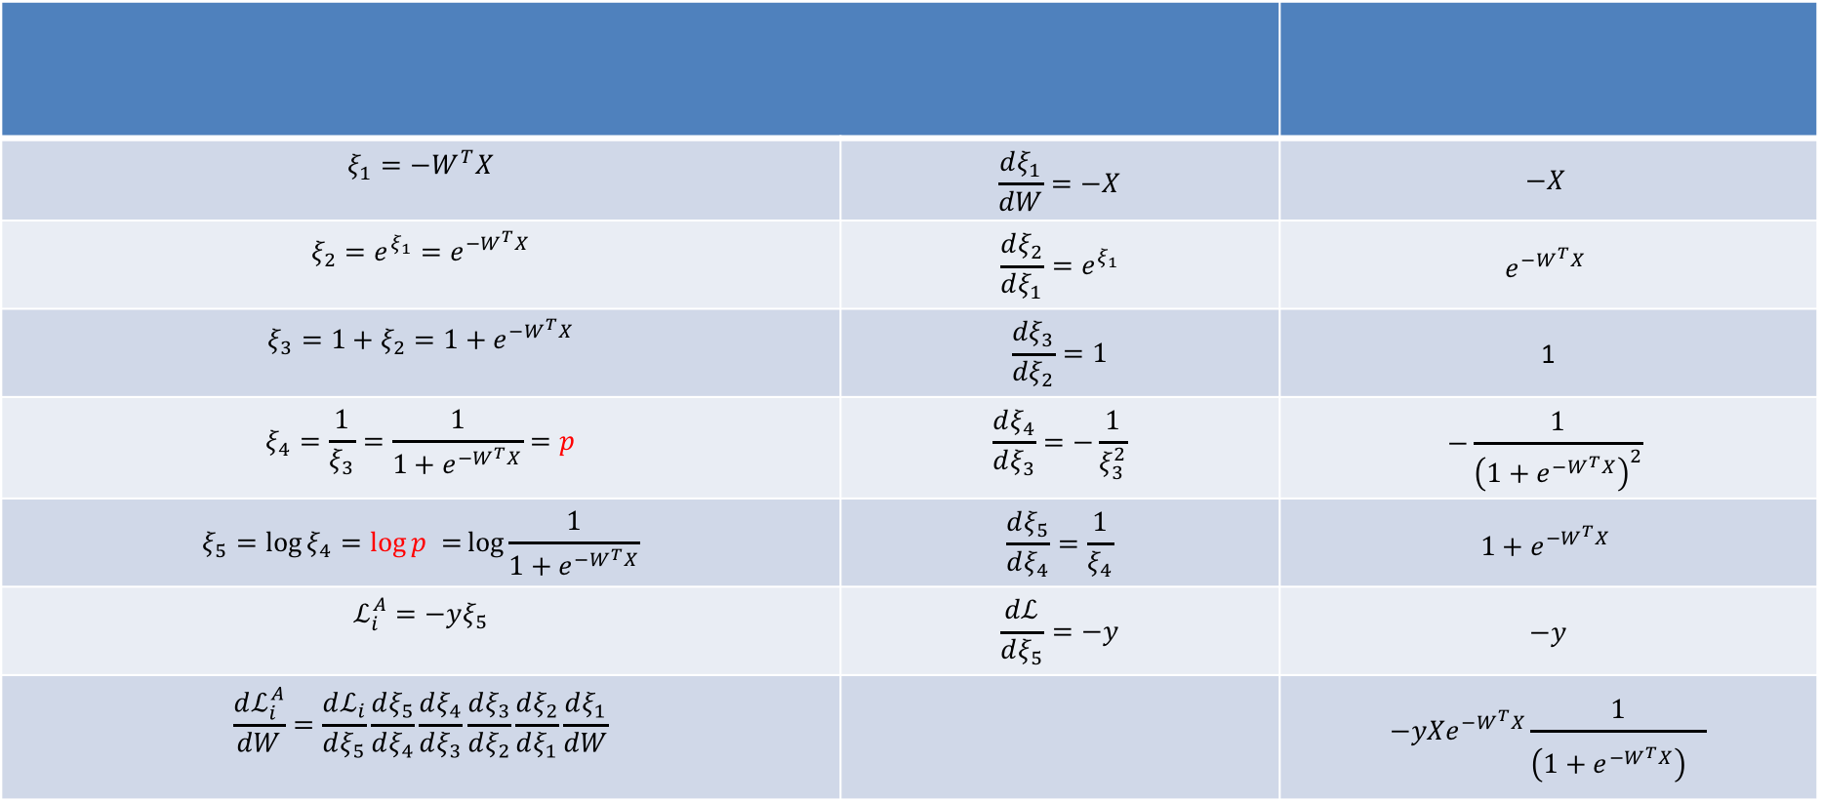
Logistic Regression
$$ξ_{1}=−W^{T}X$$ | $$\frac{dξ_{1}}{dW}=−X$$ | $$−X$$
$$ξ_{2}={e^{ξ_{1}}=e}^{−W^{T}X}$$ | $$\frac{dξ_{2}}{dξ_{1}}=e^{ξ_{1}}$$ | $$e^{−W^{T}X}$$
$$ξ_{3}=1+ξ_{2}=1+e^{−W^{T}X}$$ | $$\frac{dξ_{3}}{dξ_{2}}=1$$ | 1
$$ξ_{4}=\frac{1}{ξ_{3}}=\frac{1}{1+e^{−W^{T}X}}=p$$ | $$\frac{dξ_{4}}{dξ_{3}}=−\frac{1}{ξ_{3}^{2}}$$ | $$−\frac{1}{{\left(1+e^{−W^{T}X}\right)}^{2}}$$
$$ξ_{5}=\log{ξ_{4}=\log{p =}\log{\frac{1}{1+e^{−W^{T}X}}}}$$ | $$\frac{dξ_{5}}{dξ_{4}}=\frac{1}{ξ_{4}}$$ | $$1+e^{−W^{T}X}$$
$$ℒ_{i}^{A}=−yξ_{5}$$ | $$\frac{dℒ}{dξ_{5}}=−y$$ | $$−y$$
$$\frac{dℒ_{i}^{A}}{dW}=\frac{dℒ_{i}}{dξ_{5}}\frac{dξ_{5}}{dξ_{4}}\frac{dξ_{4}}{dξ_{3}}\frac{dξ_{3}}{dξ_{2}}\frac{dξ_{2}}{dξ_{1}}\frac{dξ_{1}}{dW}$$ |  | $${−yXe}^{−W^{T}X}\frac{1}{{\left(1+e^{−W^{T}X}\right)}^{}}$$

Slide 33
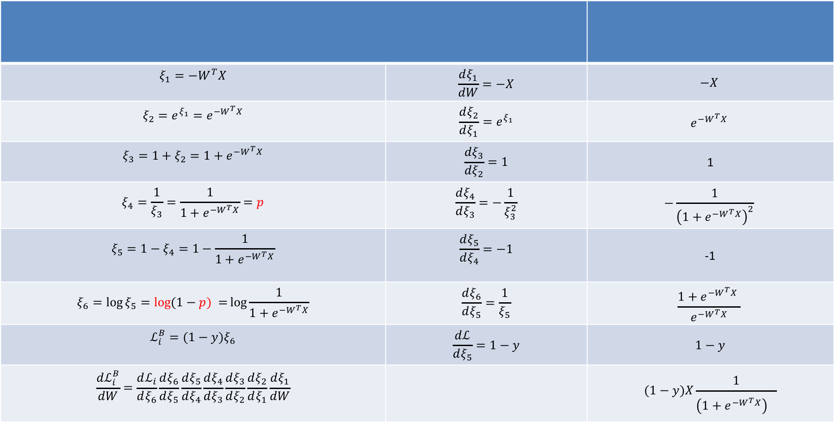
Logistic Regression
$$ξ_{1}=−W^{T}X$$ | $$\frac{dξ_{1}}{dW}=−X$$ | $$−X$$
$$ξ_{2}={e^{ξ_{1}}=e}^{−W^{T}X}$$ | $$\frac{dξ_{2}}{dξ_{1}}=e^{ξ_{1}}$$ | $$e^{−W^{T}X}$$
$$ξ_{3}=1+ξ_{2}=1+e^{−W^{T}X}$$ | $$\frac{dξ_{3}}{dξ_{2}}=1$$ | 1
$$ξ_{4}=\frac{1}{ξ_{3}}=\frac{1}{1+e^{−W^{T}X}}=p$$ | $$\frac{dξ_{4}}{dξ_{3}}=−\frac{1}{ξ_{3}^{2}}$$ | $$−\frac{1}{{\left(1+e^{−W^{T}X}\right)}^{2}}$$
$$ξ_{5}=1−ξ_{4}=1−\frac{1}{1+e^{−W^{T}X}}$$ | $$\frac{dξ_{5}}{dξ_{4}}=−1$$ | -1
$$ξ_{6}=\log{ξ_{5}=\log{(1−p) =}\log{\frac{1}{1+e^{−W^{T}X}}}}$$ | $$\frac{dξ_{6}}{dξ_{5}}=\frac{1}{ξ_{5}}$$ | $$\frac{1+e^{−W^{T}X} }{e^{−W^{T}X}}$$
$$ℒ_{i}^{B}=(1−y)ξ_{6}$$ | $$\frac{dℒ}{dξ_{5}}=1−y$$ | $$1−y$$
$$\frac{dℒ_{i}^{B}}{dW}=\frac{dℒ_{i}}{dξ_{6}}\frac{dξ_{6}}{dξ_{5}}\frac{dξ_{5}}{dξ_{4}}\frac{dξ_{4}}{dξ_{3}}\frac{dξ_{3}}{dξ_{2}}\frac{dξ_{2}}{dξ_{1}}\frac{dξ_{1}}{dW}$$ |  | $$(1−y)X\frac{1}{{\left(1+e^{−W^{T}X}\right)}^{}}$$

Slide 34
Learning Rate

Slide 35
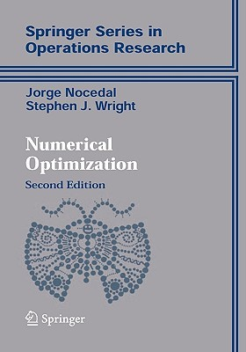
Learning Rate
Trial and Error
There are many alternative methods which address how to set or adjust the learning rate, using the derivative or second derivatives and or the momentum. To be discussed in the next ANN lecture.
J. Nocedal y S. Wright, “Numerical optimization”, Springer, 1999 🔗
TLDR: J. Bullinaria, “Learning with Momentum, Conjugate Gradient Learning”, 2015 🔗

Slide 36
Local and Global minima

Slide 37
Local vs Global Minima
L
𝛉

Slide 38
Local vs Global Minima
L
𝛉

Slide 39
Local vs Global Minima
No guarantee that we get the global minimum:
Question: What would be a good strategy?

Slide 40
Large data

Slide 41
Batch and Stochastic Gradient Descent
Instead of using all the examples for every step, use a subset of them (batch).
For each iteration k, use the following Loss function to derive the derivatives:
Which is an approximation to the full Loss function.

Slide 42
Batch and Stochastic Gradient Descent
Full Likelihood:
L
Batch Likelihood:
𝛉

Slide 43
Batch and Stochastic Gradient Descent
Full Likelihood:
L
Batch Likelihood:
𝛉

Slide 44
Batch and Stochastic Gradient Descent
Full Likelihood:
L
Batch Likelihood:
𝛉

Slide 45
Batch and Stochastic Gradient Descent
Full Likelihood:
L
Batch Likelihood:
𝛉

Slide 46
Batch and Stochastic Gradient Descent
Full Likelihood:
L
Batch Likelihood:
𝛉

Slide 47
Batch and Stochastic Gradient Descent
Full Likelihood:
L
Batch Likelihood:
𝛉

Slide 48
Batch and Stochastic Gradient Descent
Full Likelihood:
L
Batch Likelihood:
𝛉

Slide 49
Batch and Stochastic Gradient Descent
Full Likelihood:
L
Batch Likelihood:
𝛉

Slide 50
Batch and Stochastic Gradient Descent
Full Likelihood:
L
Batch Likelihood:
𝛉

Slide 51
Backpropagation

Slide 52
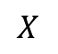
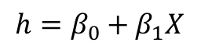
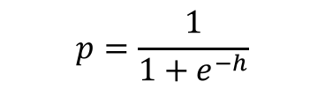
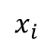
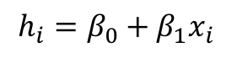
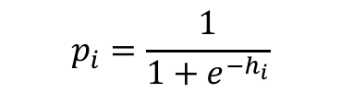
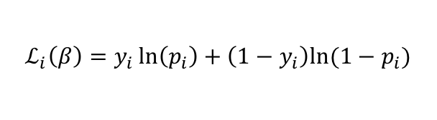
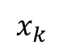
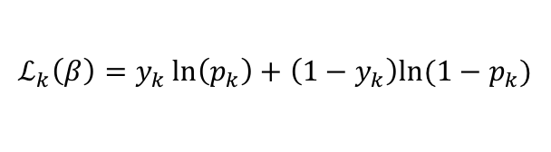
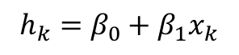
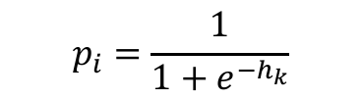

Backpropagation: Logistic Regression Revisited
Affine
Activation
Loss Fun
$$p_{i}=\frac{1}{1+e^{−h_{i}}}$$
$$x_{i}$$
$$h_{i}=β_{0}+β_{1}x_{i}$$
$$ℒ_{i}\left(β\right)=y_{i}\ln\left(p_{i}\right)+\left(1−y_{i}\right)ln⁡(1−p_{i})$$
Affine
Activation
Loss Fun
$$p_{i}=\frac{1}{1+e^{−h_{k}}}$$
$$x_{k}$$
$$h_{k}=β_{0}+β_{1}x_{k}$$
$$ℒ_{k}\left(β\right)=y_{k}\ln\left(p_{k}\right)+\left(1−y_{k}\right)ln⁡(1−p_{k})$$
…
Affine
Activation
Loss Fun
$$ℒ(β)=\sum_{i}^{n}{ℒ_{i}\left(β\right)}$$
$$p=\frac{1}{1+e^{−h}}$$
$$X$$
$$h=β_{0}+β_{1}X$$

Slide 53
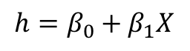
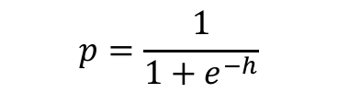
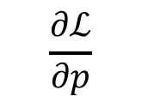
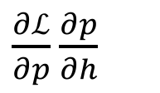
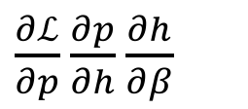

Backpropagation: Logistic Regression Revisited
Affine
Activation
Loss Fun
$$ℒ(β)=\sum_{i}^{n}{ℒ_{i}\left(β\right)}$$
$$p=\frac{1}{1+e^{−h}}$$
$$X$$
$$h=β_{0}+β_{1}X$$
$\frac{∂ℒ}{∂p}$ $\frac{∂p}{∂h}$ $\frac{∂h}{∂β}$
$\frac{∂ℒ}{∂p}$ $\frac{∂p}{∂h}$
$$\frac{∂ℒ}{∂p}$$

Slide 54
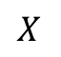







Build our first ANN
Affine
Activation
Loss Fun
$$ℒ(β)=\sum_{i}^{n}{ℒ_{i}\left(β\right)}$$
$$p=\frac{1}{1+e^{−h}}$$
$$X$$
$$h=β_{0}+β_{1}X$$
Affine
Activation
Loss Fun
$$ℒ(β)=\sum_{i}^{n}{ℒ_{i}\left(β\right)}$$
$$p=\frac{1}{1+e^{−h}}$$
$$X$$
$$h=Xβ$$
Affine
Activation
Loss Fun
$$ℒ(W)=\sum_{i}^{n}{ℒ_{i}\left(W\right)}$$
$$y=\frac{1}{1+e^{−h}}$$
$$X$$
$$h=XW$$

Slide 55





Build our first ANN
Affine
Activation
Loss Fun
$$ℒ(W)=\sum_{i}^{n}{ℒ_{i}\left(W\right)}$$
$$p=\frac{1}{1+e^{−h}}$$
$$X$$
$$h=XW$$
$$X$$
$$Y$$
Single Neuron Network
Very similar to Perceptron

Slide 56

Example Using Heart Data
Slightly modified data to illustrate concepts.

Slide 57



Example Using Heart Data
$$X$$
$$Y$$

Slide 58






Example
$$X$$
$$Y$$
$$X$$
$Y$’

Slide 59








Pavlos game #232
W₁
W₁
$$X$$
$$Y$$
$$h_{1}$$
$$h_{1}+h_{2}$$
$$X$$
W₂
W₂
$$h_{2}$$
$$X$$
$$Y′$$

Slide 60



Pavlos game #232
$$q= W_{31}h_{1}+{W_{32}h}_{2}+W_{30}$$
$$y=\frac{1}{1+e^{−q}}$$
W₁
W₁
$$X$$
$$Y$$
$$h_{1}$$
$$W_{3}$$
$$X$$
W₂
W₂
$$h_{2}$$
$$X$$
$$Y$$

Slide 61


Pavlos game #232
$$q= W_{31}h_{1}+{W_{32}h}_{2}+W_{\begin{aligned}30 \\ \end{aligned}}$$
$$p=\frac{1}{1+e^{−q}}$$
W₁
W₁
$$X$$
$$Y$$
$$h_{1}$$
$$W_{3}$$
$$X$$
W₂
W₂
$$h_{2}$$
$$X$$
$$Y$$
$$L=y ln\left(p\right)+\left(1−y\right)ln(1−p)$$

Slide 62



Example Code

Slide 63

Artificial Neural Networks
Machine Learning Algorithm
Very simplified parametric models of our brain
Networks of basic processing units: neurons
Neurons store information which has to be learned
Many types of architectures to solve different tasks
They can scale to massive data
They can train in parallel
...
...
...
...
...
99.9%
dog

Slide 64
Motivation #1

Slide 65

Finding parameters for Logistic Regression
Recall in previous lecture we talk about finding the parameters of Logistic Regression using iterative method.
“The estimation procedure is identical to that as before for simple logistic regression:
a likelihood approach is taken, and the function is maximized across all parameters $β_{0}$, $β_{1},…,β_{p}$ using an iterative method like Newton-Raphson... ”
We will learn how to do actually find the solution.

Slide 66




Newton’s Method
A second order algorithm for optimization for finding a minimum of a function $L$.
An iterative method.
The gradient informs the best direction to descent $L$.
The Hessian informs the best step size to descent $L$.

Slide 67
Motivation #2

